Slide 1
Welcome to Year Two!
Parent’s Information Meeting
Tuesday9th September

Slide 2
All About us
Class Teachers-
Mrs Adams (Monday, Tuesday and Wednesday)
Mrs Hemsley (Thursday and Friday)
Teaching Assistants-
Mrs Weller (Monday, Tuesday, Wednesday, Thursday and Friday mornings)
Mrs Greensmith (Wednesday all day and Thursday afternoon)

Slide 3

Our School Rules
Our whole school community follows three rules:
Be Ready
Be Respectful
Be Safe

Slide 4

Our School Values
We try to instil these values in our whole school community.
At Stocks Green we are:
Kind
Respectful
Honest
Resilient
Inclusive

Slide 6

Notes:
Please note further information about this will be coming out to parents in the next few weeks once all trips and events have been booked.

Slide 7




Our Curriculum:
Our Year 2 Curriculum Overview will be available on the website shortly.

Slide 8
Learning/Groups
Most learning in English and Maths will consist of whole class teaching, followed by independent or group tasks with children generally grouped with those of a similar ability, however some mixed ability groupings will be used when we feel it is appropriate.
The children will have talk partners to enable them to share their thoughts and ideas. We will aim to change talk partners every term to encourage your children to make new friends, support one another and develop their social communication skills.

Slide 9
PE
In Term 1 our PE will be on Tuesdays and Wednesdays.
This will change in other terms. We will inform you of any changes at the beginning of a new term.
The children should wear their PE kit on this day.
Sport Clubs
Morning – your child should change into his/her uniform after the club.
Afternoon – your child should change into his/her PE kit after school.

Slide 10
Snack
Children are all provided with a healthy snack every day. Children are also welcome to pack an appropriate healthy snack, e.g. a piece of fruit or vegetables, should their child like one.
Water Bottles
Please provide water only in your child’s water bottle.

Slide 11

Homework
Our school has recently reviewed its homework policy.
The home work expectations for our year group are…
Reading: 10 minutes per day, including reading to an adult and being
read to by an adult.
Spelling: 5 minutes of spelling practise twice a week
Maths: 5 minutes practise of 2x, 5x and 10x tables per week.

Slide 12
Homework
In addition to the weekly homework tasks already mentioned we will also be setting OPTIONAL termly homework projects in order to inspire your children to extend their learning beyond the classroom.
Each term two optional tasks, related to the current learning in history, geography or science, will be published on our class page on the school website for pupils who wish to explore them.
We would love to see any completed tasks in school or via email.

Slide 13
Suggested ways to learn your spellings/phonics:
Your child will continue to use our Phonics / Spelling programme Sounds Write, focusing on the Extended Code.
https://sounds-write.co.uk/support-for-parents-and-carers/
Free online course run by Sounds Write which is a step by step guide to phonics.
Try and make it as interactive as possible.
Online platforms such as Phonics Play; https://www.phonicsplay.co.uk/resources

Slide 14
Suggested ways to learn your times tables
Online platforms such as “Hit the Button” and TT Rockstars. Will supply log ins.
Visually, via number squares, colouring, writing out, flash cards
Orally, via singing games
Power Towers – A game to play in pairs. Write multiplication problem on the outside of the paper cup and write the answer on the inside on the bottom. If the child gets the correct answer, they can begin making a tower. Each time a correct answer is given they can add to the stack.
Ping Pong – children turn take with a partner asking and responding to x tables questions e.g. if the game is for 2 times table – quiz master says 4 and responder answers 8 (2 x 4 ) etc

Slide 15
Reading
Your child will be sent home with two reading books every Monday. Please make sure to return these the following Monday to allow them to be changed.
Your child will have a reading record, please can you record and sign when/how much they have read each week ☺ Please can children bring their reading record to school every day so that we can monitor their progress. Please do not write any messages in these.
As in Year 1 it is important that your child reads with you regularly (ideally every day). If this is proving challenging for any reason then please come and see us and we can help find a solution/strategy to help.
We will be having daily phonics lessons and 1:1 reading with CT or TA when appropriate. After Christmas we will also be carrying out daily reading lessons. to help the children develop all their reading skills, such as fluency, expression and comprehension.

Slide 16
Assessments:
Ongoing assessments will be completed throughout the year.
Assessments are undertaken to identify what progress has been made as well as gaps, targets and next steps.
Sometimes assessments are formal tests but at other times they are informal, for example quizzes, looking at the children’s work or listening to their contributions in class.
Statutory Assessments Phonics Check – End of Autumn 2023
Stage 1 SATs – end of year

Slide 17
Communication
As a school we will always look to resolve any issues for you. As such, we would suggest that the best way to address any concerns is to speak to us on the classroom door so we can resolve them as quickly as possible.
However, as a school, we do appreciate this might not always be possible. So, our class email address is class2@stocks-green.kent.sch.uk
Please bear in mind that we will only be checking and answering emails in work hours between 7:30am and 5:00pm and at busy times it may take up to 48 hours to respond. If your enquiry is more urgent that this, please contact the school office.

Slide 18
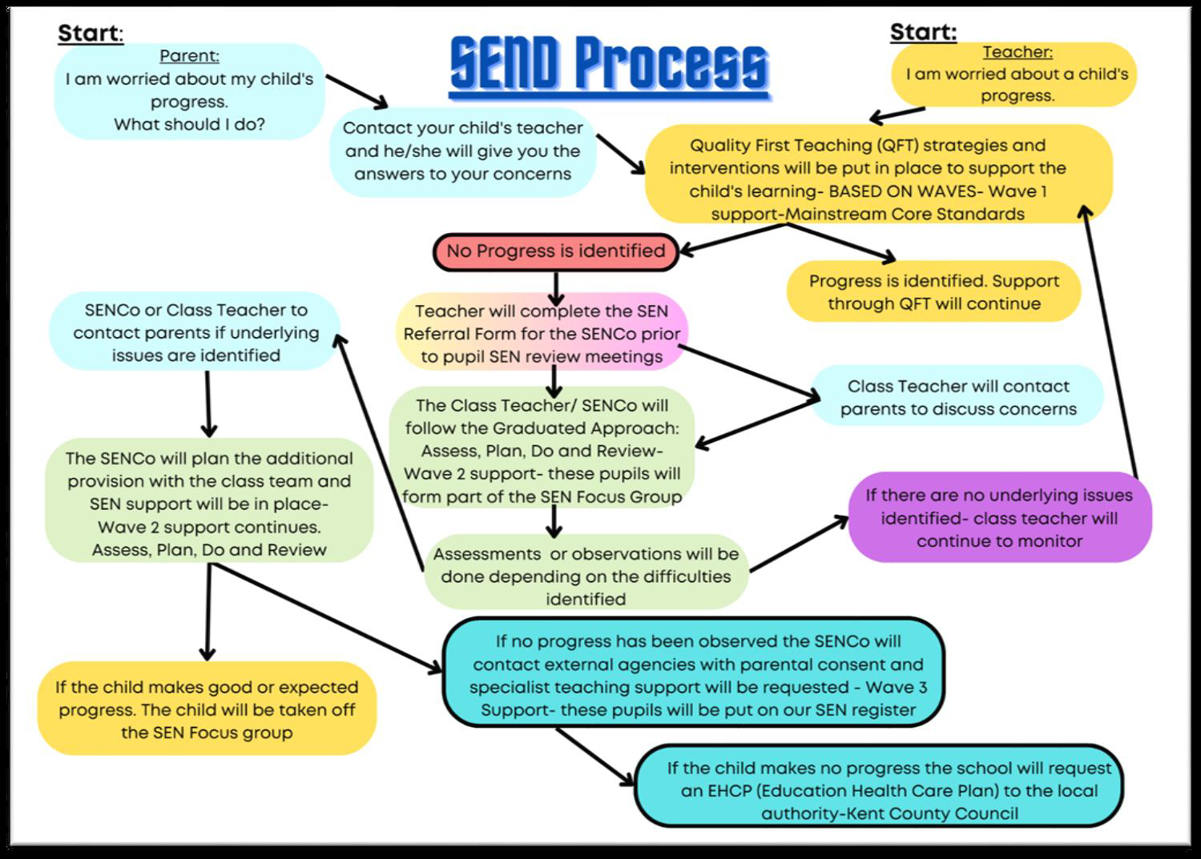
Concerns about your child’s progress

Slide 19
Support with the cost of living and additional funds for the school.
In school, children in Year R, 1 and 2 receive Universal Infant Free School Meals. However, if you are in receipt of certain benefits, you can also receive a free school meal in Years 3 - 6. To check your eligibility and register for this, you would need to search ‘Kent Free School Meals’ or go to:
https://www.kent.gov.uk/education-and-children/schools/free-school-meals
There is a double benefit to this, as the school will also receive an additional £1480 per pupil to support their learning and the teaching and learning across the school.
Even if your child is in Years R, 1 or 2 and already receives a free school meal, signing up can support their learning by accessing the additional funding.

Slide 20
We are looking forward to a busy and exciting year and look forward to working with you.

