Slide 1


Slide 2
Curriculum Information
September 2025
The teaching and learning in our Reception Class is based on the Statutory Framework and Early Years Foundation Stage (EYFS) curriculum introduced by the Government in September 2012 and then revised in 2021. There are seven areas of ‘Learning and Development’, and, as in the past, children work towards meeting the ‘Early Learning Goals’ specified in the Framework.

Slide 3
There are 17 Early Learning Goals.
The EYFS Framework clearly emphasises the importance of play and active learning to enable children to explore, investigate, use their imagination, build relationships and become critical thinkers. It recommends that schools provide an appropriate balance of child-led activities with teacher and adult support to underpin learning across all areas, in order to support child development and ensure that they remain effective and motivated learners.

Slide 4
The 7 areas of learning in the EYFS curriculum
Prime Areas
Communication and Language
Physical Development
Personal, Social and Emotional Development
Specific Areas
Literacy
Mathematics
Understanding of the World
Expressive Arts and Design

Slide 5
This involves giving children opportunities to experience a rich language environment; developing their confidence and skills in expressing themselves and encouraging speaking and listening in a wide range of situations.
Communication and Language

Slide 6
Children will be provided with opportunities to be active and to develop their co-ordination and control. They will be helped to understand the importance of physical activity and to begin to make healthy choices.
Physical Development

Slide 7
This involves helping children to develop a positive sense of themselves, to work co-operatively with others, to manage their emotions and to respect the feelings of others.
Personal, Social and Emotional Development

Slide 8
Within the class, the whole school and at home, children should have access to a wide and varied range of reading materials (books, poems, posters, magazines, etc.) to ignite and sustain their interest. They will be encouraged to develop their phonological awareness and begin to hear sounds within words and to then link sounds to letters in order to begin to read and write.
Literacy

Slide 9
In whole class and small group activities the children will be taught to recognise, subitise, read and order numbers to 10 and then to 20 or beyond. The focus is on developing an excellent understanding and deep knowledge of numbers to 10. Through child-led activities and teacher directed tasks they will be given opportunities in play to develop and improve their skills in counting, understanding and using numbers, calculating and exploring shapes and measurements.
Mathematics

Slide 10
This involves guiding children to make sense of their physical world and their community through opportunities to explore, observe and find out about people, places, technology and the environment.
Understanding of the World

Slide 11
Within a creative environment children will be encouraged to explore and play with a wide range of media and materials. They will have opportunities to share their thoughts, ideas and feelings through a variety of activities in art, music, dance, role-play and design and technology.
Expressive Arts and Design

Slide 12
General information
Mrs Greensmith is the Teaching Assistant (TA) in Reception on Monday and Tuesday.
Mrs Hayward is the Teaching Assistant (TA) on Wednesday to Friday.
Mrs Hayward will take the class on one session whilst I am out of class undertaking planning and preparation tasks (PPA) with other teaching staff.

Slide 13

Our School Rules
Our whole school community follows three rules:
Be Ready
Be Respectful
Be Safe

Slide 14

Our School Values
We try to instil these values in our whole school community.
At Stocks Green we are:
Kind
Respectful
Honest
Resilient
Inclusive

Slide 15

Homework
Our school has recently reviewed its homework policy. The home work expectations for children in EYFS are that they read daily at home for 10 minutes, including reading to an adult and being read to by an adult. And that they spend 5 minutes twice a week practising number skills – counting, recognising numbers and number bonds to 5 and 10.

Slide 16

Notes:
Please note further information about this will be coming out to parents in the next few weeks once all trips and events have been booked.

Slide 17
Newsletter
A brief newsletter setting out the week’s learning will be sent home at the start of each week. Please note, the letter will also be posted on the Stocks Green website.

Slide 18

Water Bottle
Please bring in a named water bottle containing fresh water every day. This will be available to your child throughout the day and refilled as necessary.

Slide 19

Home Contact Book
Please return this book in your child’s book bag every day with any relevant comments. It will be checked every morning. Please let us know if your child will be collected by someone other than a parent or is attending afterschool club.

Slide 20
Communication
As a school we will always look to resolve any issues for you. As such, we would suggest that the best way to address any concerns is to speak to us on the classroom door so we can resolve them as quickly as possible.
However, as a school, we do appreciate this might not always be possible. So, our class email address is on our class page of the website.
classr@stocks-green.kent.sch.uk
Please bear in mind that we will only be checking and answering emails in work hours between 7:30am and 5:00pm and at busy times it may take up to 48 hours to respond. If your enquiry is more urgent that this, please contact the school office.

Slide 21
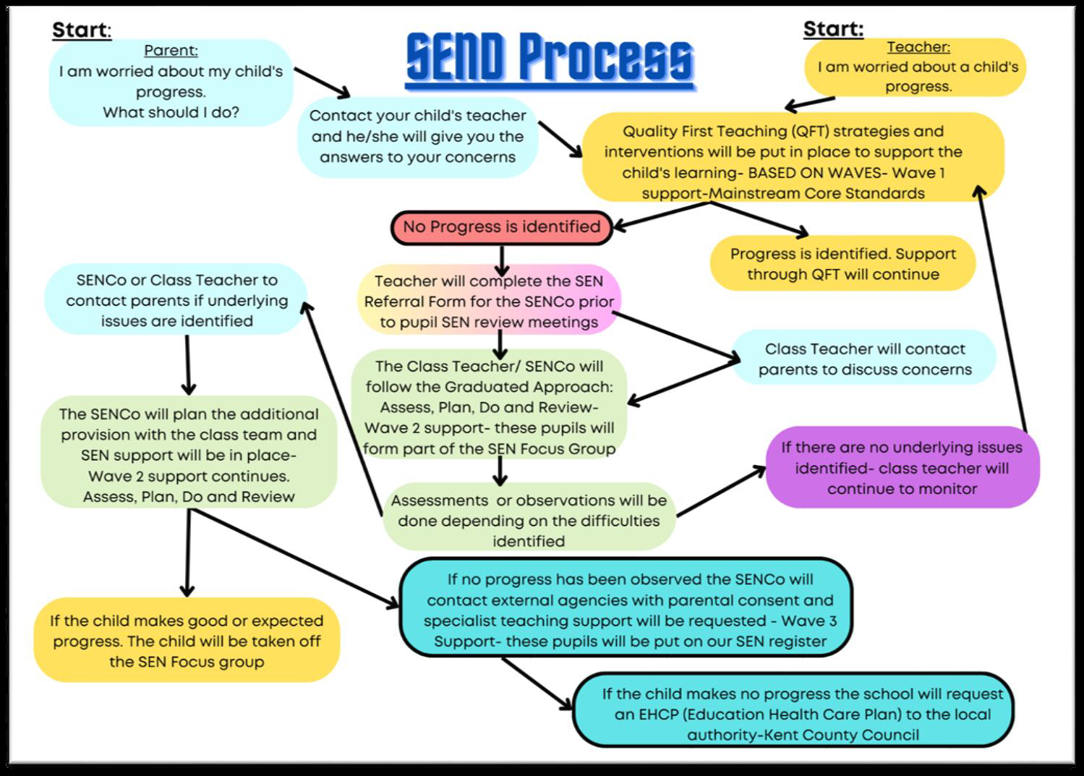
Concerns about your child’s progress

Slide 22
House Teams
At school we four different house teams and the children will be allocated to each house. We always put siblings into the same team. The houses are also colour co-ordinated. We will put a label into the children’s contact book to inform you of their house team.

Slide 23

Year 6 Buddies
Next week your child will be bringing home a letter from their Year 6 Buddy. We use the Buddy system to help settle the new YR children into school and as a mentoring opportunity for our Year 6 children.

Slide 24
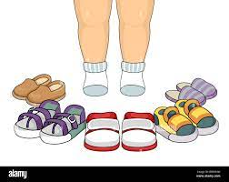
Name labels
To avoid loss of school uniform and belongings, please ensure that everything is clearly named, especially shoes.

Slide 25

Wellington Boots
It is essential that your child has a pair of Wellies in school throughout the year, so that we can play outdoors and visit the woodland area - even when it’s wet and muddy!

Slide 26
PE
We will begin timetabled PE lessons in a few weeks and we will let you know the day as the children will need to come into school in their PE kits.

Slide 27
Lunches
Each morning I complete the dinner register as to whether the children are having a school lunch or packed lunch. School dinners are free to all EYFS and KS1 pupils.

Slide 28
Packed Lunch
Our school is a ‘Nut-free School’ to protect children who have a nut allergy. It is school policy that there should be no nut products in packed lunches, for example ‘Nutella’ or some cereal bars.

Slide 29
Support with the cost of living and additional funds for the school.
In school, children in Year R, 1 and 2 receive Universal Infant Free School Meals. However, if you are in receipt of certain benefits, you can also receive a free school meal in Years 3 - 6. To check your eligibility and register for this, you would need to search ‘Kent Free School Meals’ or go to:
https://www.kent.gov.uk/education-and-children/schools/free-school-meals
There is a double benefit to this, as the school will also receive an additional £1385 per pupil to support their learning and the teaching and learning across the school.
Even if your child is in Years R, 1 or 2 and already receives a free school meal, signing up can support their learning by accessing the additional funding.

Slide 30


Snack and Milk
Free fruit is supplied by Kent County Council to all children in EYFS and KS1 and will be offered to children at snack-time (10:15am). Parents can provide fruit or vegetable alternatives if they wish.
All children below the age of 5 years are entitled to a carton of free milk each day. From the age of 5 upwards, a small charge is levied. You can register your child on-line on or by post (please ask for details).

Slide 31
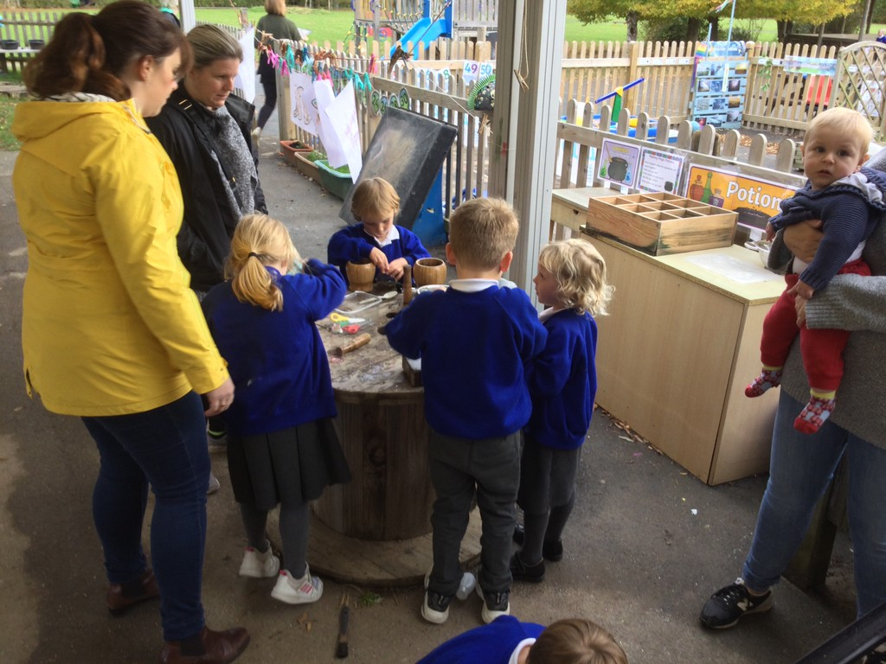
Parents as Partners
We will hold two sessions of ‘Parents as Partners’ this year. This is when parents are invited to attend a Child Initiated Play session to share in their child’s learning. Our first session will be held on Thursday 13th November at 14:00 to allow children time to settle into school. With another session on Wednesday 11th March 2026.

Slide 32

Reading
Your child will be encouraged to take home a book of their choice every day, known as a ‘Choosing Book’. This is for you to share with your child. When you are ready, please return the book so that your child can choose another book to take home.

Slide 33
Phonics
We will begin our Phonics learning as soon as all the children are in school. First we will work on developing their listening skills and then begin to introduce the letter sounds using the Phonics scheme ‘Sounds Write’. We will inform you of the weeks sounds in the weekly newsletter. Please help your child to learn the sound that each letter or combination of letters makes and to practise forming the letters if they wish.

Slide 34

Reading Books
When children are ready, they will begin to bring home a reading book. Further information about supporting your child’s reading development and phonics learning will be discussed at a Parents Phonics and Reading session, to be held later on in the Autumn Term.

Slide 35
Writing
Handwriting
As a school we introduce writing on entry and as we begin our Phonics learning we will introduce the letter formation.

Slide 36
Name Cards
Our main focus this term will be to enable the children to write their names in the correct letter formation. To support this we will make each child a name card to practice their name. We will keep one card in school and will also send one home so that you can also practice at home.

Slide 37
Our Possible Topics
Term 1: ‘All About Me’, ‘My Family’ and ‘My School’
Term 2: ‘Seasons - Autumn’, ‘Long Ago’ and the celebrations of ‘Diwali’ and ‘Christmas’
Term 3: The celebrations of ‘New Year’, ‘Chinese New Year’, ‘Keeping Healthy’ and ‘Light and Dark’
Term 4: ‘Seasons - Spring’, ‘Growing Things’, ‘How Things Work’ and ‘Jobs’
Term 5: ‘Animals and Humans’, ‘Africa’ and ‘Fairytales’
Term 6: ‘Seasons - Summer’, ‘Robots’ and ‘Moving On’
All topics are subject to change as we will look to develop the curriculum based upon the interests of the children.

Slide 38
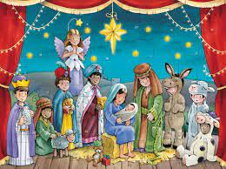
Christmas is coming!
Dates for our Nativity
Grandparents performance 8th December
Parents performance 9th and 10th December

Slide 39
We are very excited to welcome your children into the school and begin their learning journey in formal education. If you have any further questions or queries please do not hesitate to ask. We are available to chat most evenings after school, send us an email or please telephone the school office to make an appointment.
With thanks Mrs Hodgson,
Mrs Greensmith and
Mrs Hayward

